Slide 1
DYNAMIC FRACTURE MODELS topics for discussion
may 7, 2024
Renato poli

Slide 2
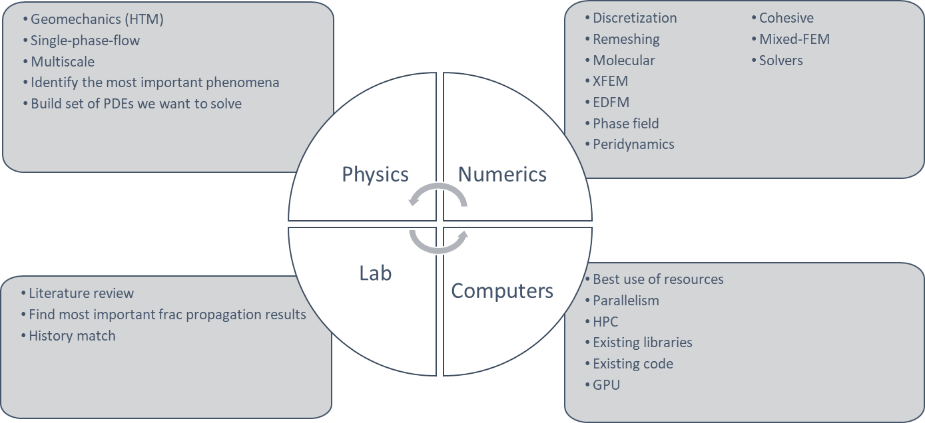
TECHNOLOGY AXES

Slide 3
PROBLEM FRAME
Conventional reservoirs
Naturally fractured
Layered
Salt or shale caprock
High temperature contrast
PROBLEM
SOLUTION

Slide 4

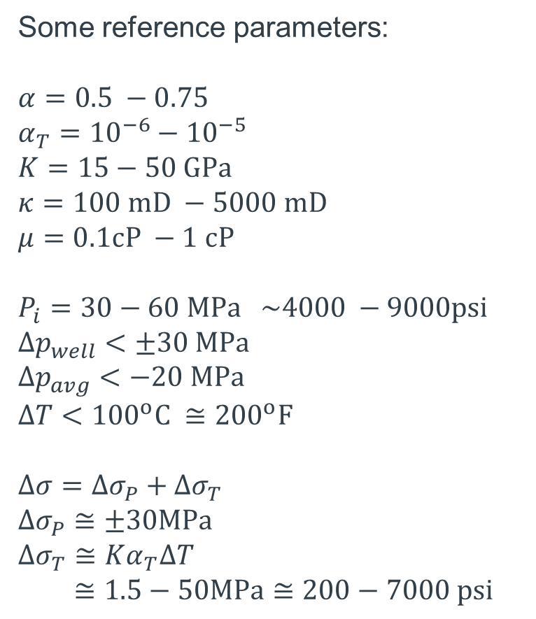

LOCALIZATION OF THE INVESTIGATION
Some reference parameters:
$$α=0.5 −0.75$$
$$α_{T}={10}^{−6}−{10}^{−5}$$
$$K=15−50 GPa$$
$$κ=100 mD −5000 mD$$
$$μ=0.1cP −1 cP$$
$$P_{i}=30−60 MPa \sim 4000 −9000psi$$
$$Δp_{well}<±30 MPa$$
$$Δp_{avg}<−20 MPa$$
$$ΔT<{100}^{o}C ≅{200}^{o}F$$
$$∆σ=∆σ_{P}+∆σ_{T}$$
$$∆σ_{P}≅±30MPa$$
$$∆σ_{T}≅Kα_{T}ΔT$$
$≅1.5−50MPa≅200−7000 psi$
$$1−2 km$$
$$<300 m$$
Notes:
FLUID FRONT IN BLUE
TEMPERATURE FRONT IN RED

Slide 5
THE IMPACT OF FRACTURE DYNAMICS
Some reference parameters:
$$α=0.5 −0.75$$
$$α_{T}={10}^{−6}−{10}^{−5}$$
$$K=15−50 GPa$$
$$κ=100 mD −5000 mD$$
$$μ=0.1cP −1 cP$$
$$P_{i}=30−60 MPa \sim 4000 −9000psi$$
$$Δp_{well}<±30 MPa$$
$$Δp_{avg}<−20 MPa$$
$$ΔT<{100}^{o}C ≅{200}^{o}F$$
$$∆σ=∆σ_{P}+∆σ_{T}$$
$$∆σ_{P}≅±30MPa$$
$$∆σ_{T}≅Kα_{T}ΔT$$
$≅1.5−50MPa≅200−7000 psi$
$$1−2 km$$
$$<300 m$$
Notes:
WHICH FRACTURE DYNAMICS SHOULD WE STUDY?

Slide 6
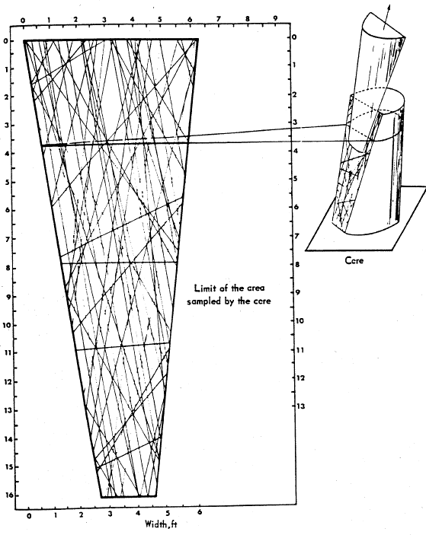
THE SCALE OF FRACTURES
Notes:
WE NEED TO CONSIDER OUR ENTITIES AS NUMERICAL ABSTRACTIONS.

Slide 7



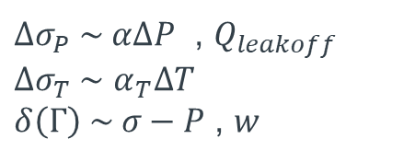
THE FRACTURE PHYSICS
$$∆σ=∆σ_{P}+∆σ_{T}$$
$$P(Γ)≤σ(Γ)$$
$$w(Γ)$$
$$δ(Γ)$$
$∆σ_{P} \sim α∆P$ , $Q_{leakoff}$
$∆σ_{T} \sim$ $α_{T}∆T$
$δ\left(Γ\right) \sim σ−P$ , $w$

Slide 8
FRACTURE TRANSMISSIBLITY?
It is very difficult to apply the cubic law in a unpropped natural fractures
The uncertainty is too high.
Suggestion: derive from data
(however) Which observable field data contains this information?

Slide 9


FRACTURE INTERACTION IN CONVENTIONALS
$$σ_{max}$$
$$σ_{min}$$
Notes:
WHEN ONLY PRESSURE IS CONSIDERED, THE PREFERENTIAL PROPAGATION DIRECTION DOES NOT CHANGE

Slide 10
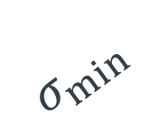


FRACTURE INTERACTION IN CONVENTIONALS
$$ΔT$$
$$σ_{max}$$
$$σ_{min}$$
Notes:
WHILE THE PRESSURE RISE INCREASES THE CONTRAST, THE TEMPERATURE REDUCTION DECREASES THE CONTRAST CAUSING BRANCHING

Slide 11
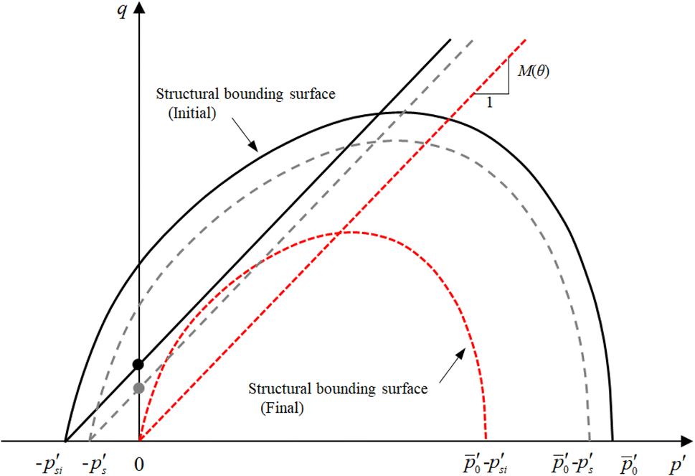
PLASTICITY
Notes:
THE HIGH STRAIN AROUND THE FRACTURE IS CRITICAL FOR THE ROCK STRUCTURE.
PLASTICITY IS LIKELY TO HAPPEN AND CHANGE THE PROPERTIES DYNAMICALLY

Slide 12
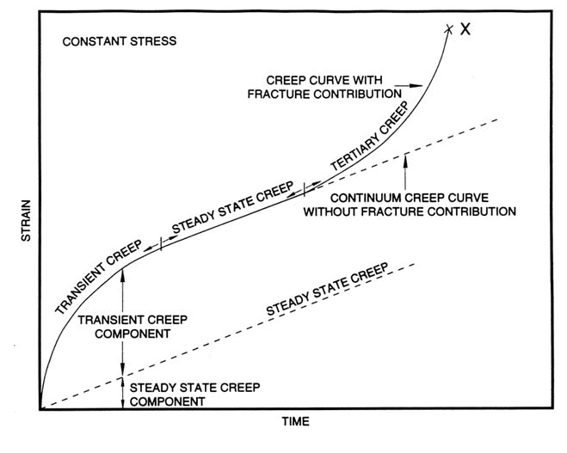
SALT CREEP
Notes:
SALT IS A CAPROCK IN PRE-SALT FIELDS
IT IS ALSO IMPORTANT TO INVESTIGATE CREEP IF WE ARE TO MODEL MECHANICS OF SALT CAVERNS

Slide 13
OPEN STATEMENTS TO INVESTIGATE
CLAIM | Maturity
PHYSICS
Multiphase flow does not impact fracture propagation as long as we estimate the global temperature and pressure fields well. | Believe
Multiphase flow has limitations when using EDFM in NFR due to the upwind numerical strategies of the commercial simulators. | Believe. Need to investigate.
The fracture dynamics we are interested in (NF distributed along the reservoir, temperature-driven) are not planar. Branching and fracture swarms are a fact. | Evidence
LEFM is insufficient for fracture propagation in conventional reservoirs, and plasticity plays a role. | Don't know. Need to investigate
Creep is important to model fracture propagation in a salt layer, as it acts within minutes-to-hours. | Believe
Reactive transport does not play a role in propagation but may fill the fracture and reduce permeability. | Believe
Fracture propagation characteristic time concur with pressure diffusion in early times or with high-efficiency fluids (fully coupling may apply). Higher times are expected otherwise (weak coupling is enough) | Believe

Slide 14
OPEN STATEMENTS TO INVESTIGATE
CLAIM | Maturity
NUMERICS
Only small-scale meshes can deal with the complex physics of fracture propagation. | Believe
EDFM works in coarse meshes and has no resolution to model physics behind fracture propagation driven by low-efficiency fluids. In fine meshes, we know better technology. | Believe. Do we have enough evidence from Lily's work?
Phase field models are expensive for 3D models because they require high resolution to map a 2D mesh in volumes. We do not know any technology to overcome that. | Believe
FEM provides more mathematical flexibility than FVM and FDM to work with fracture mechanics. | Believe
We can numerically estimate the velocity vector at the tip of an existing fracture, which can be mapped to a point (2D domain) or a line (3D domain). | Don't know. Need to investigate.
We can numerically estimate a nucleation vector in any point P of the continua. | Don't know. Need to investigate.
Conforming meshes require remeshing but are still less expensive because they explicitly represent the fracture domain. | Believe
Non-conforming meshes are less expensive because they do not require remeshing. The technologies are ILSA, XFEM, Phase-field, SBFEM. | Evidence
Non-conforming meshes have difficulty dealing with fracture interaction because they need to embed complex scenarios into the equations. (no explicit fracture representation) | Evidence

Slide 15
OPEN STATEMENTS TO INVESTIGATE
CLAIM | Maturity
APPLICATIONS
NF opening or new fractures propagating as a strain release mechanism due to low-temperature fluid injection. | Believe
Natural fractures closure due to reservoir depletion. | Evidence. Simple tables in flow simulators can handle effectively.
Cold drilling fluids are enough to fracture the rock even in original pressure. | Believe
Salt cavern fracture analysis for safety needs hundreds to thousands of years. | Evidence. Does any simulator can handle this?
Secondary fractures in geothermal systems due to the pressure gradient. | Evidence
Increase in HF effective stress due to depletion, causing proppant crushing | Evidence. Existing simulators can handle effectively.

Slide 16
Ongoing development
may 7, 2024
Renato poli

Slide 17
Research
Phenomenological investigation of fracture dynamics in 3D
Integrate fracture dynamics in reservoir simulation
Remarks
Geomechanics effects are often analyzed with more complexity than necessary for conventionals
Need an application where geomechanics is relevant and cannot be handled by linear tables for porosity/permeability or plane strain simulation
Application ideas
Non-isothermal water/gas injection in carbonates (NFR)
Fracture propagation and fluid containment with salt as caprock
PAPER RECOMMENDATION: SPE219461

Slide 18
Strategy
develop simulation routines gradually
find intermediate applications for valitation and maturing
Starting point
The elastic homogenization application we are working on
Where we are
Validation went through
Mesh generator used to work …
Next step
Generate meshes
Run simples testcases

Slide 19
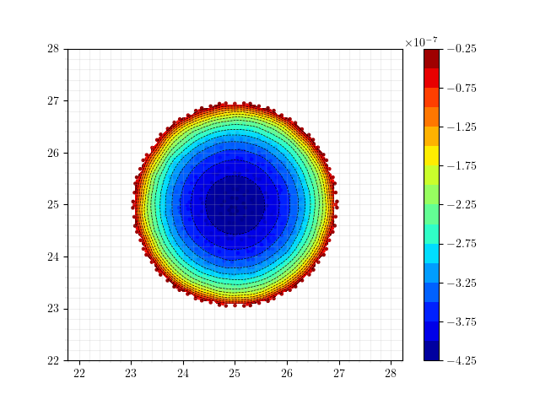
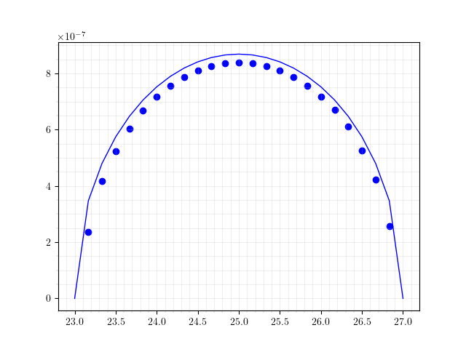
SNEDDON, COARSE MESH
Book (VALKO, ECONOMIDES)
Mesh Information:
elem_dimensions()={3}
spatial_dimension()=3
n_nodes()=13086
n_local_nodes()=3829
n_elem()=9138
n_local_elem()=2285
n_active_elem()=9138
Time: 10s
Maximum UZ displacement: 4.1952e-07
WMAX: 4.3450e-07
ERR: -3.45 %

Slide 20
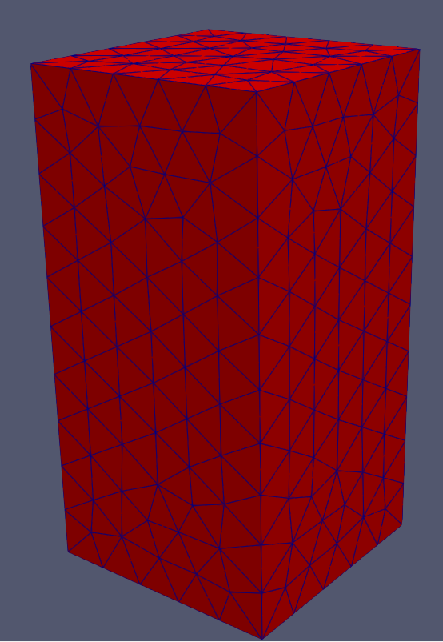
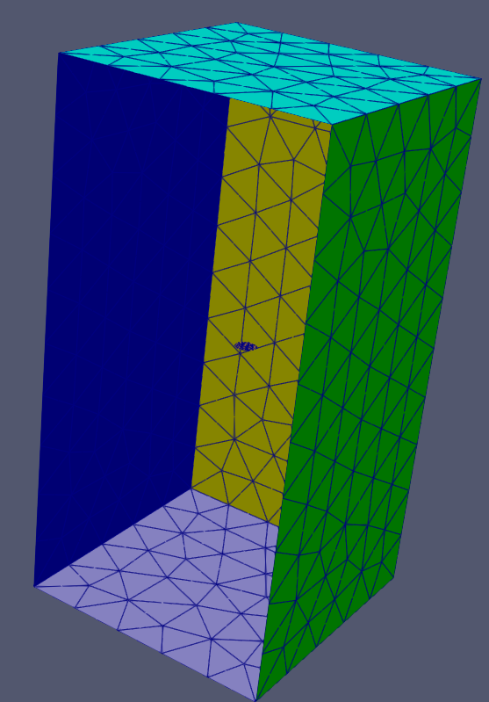
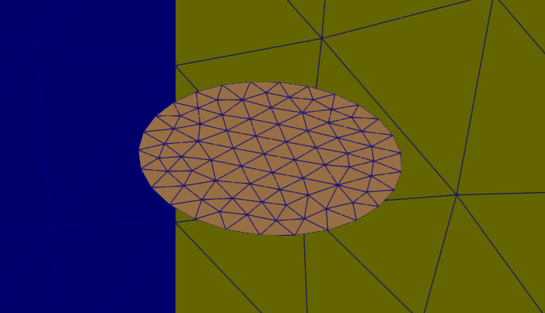
SNEDDON, COARSE MESH
ISOGEOMETRIC ANALYSIS?
Mesh Information:
elem_dimensions()={3}
spatial_dimension()=3
n_nodes()=13086
n_local_nodes()=3829
n_elem()=9138
n_local_elem()=2285
n_active_elem()=9138
Time: 10s
Maximum UZ displacement: 4.1952e-07
WMAX: 4.3450e-07
ERR: -3.45 %

Slide 21
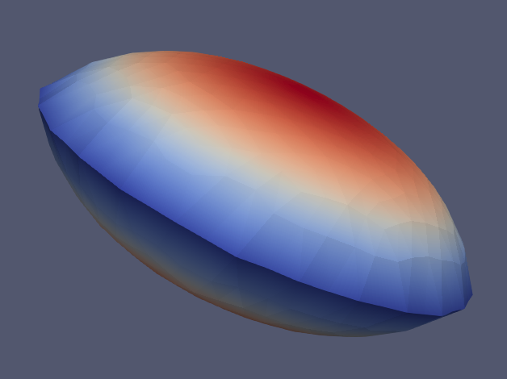
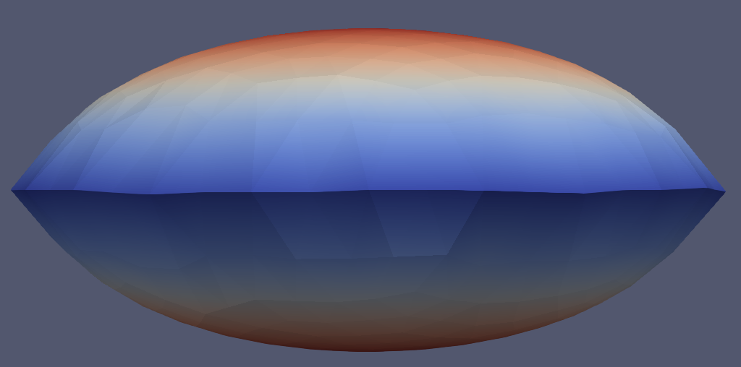
SNEDDON, COARSE MESH
Mesh Information:
elem_dimensions()={3}
spatial_dimension()=3
n_nodes()=13086
n_local_nodes()=3829
n_elem()=9138
n_local_elem()=2285
n_active_elem()=9138
Time: 10s
Maximum UZ displacement: 4.1952e-07
WMAX: 4.3450e-07
ERR: -3.45 %

Slide 22
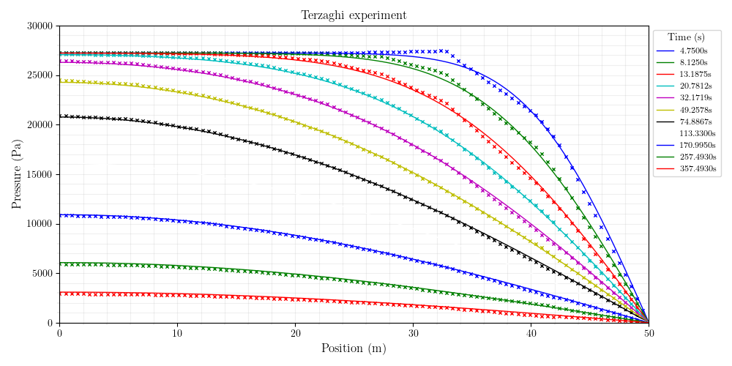
Mesh Information:
elem_dimensions()={3}
spatial_dimension()=3
n_nodes()=1798
n_local_nodes()=515
n_elem()=942
n_local_elem()=235
n_active_elem()=942
TERZAGHI, CRANK NICHOLSON (9s)

Slide 23
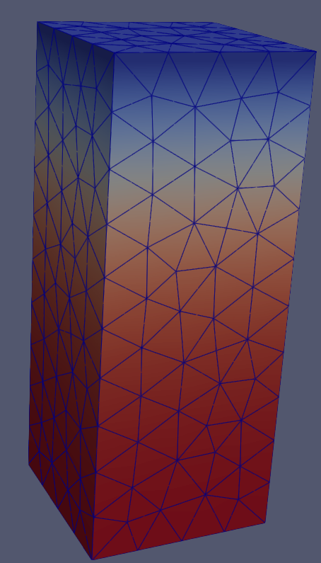
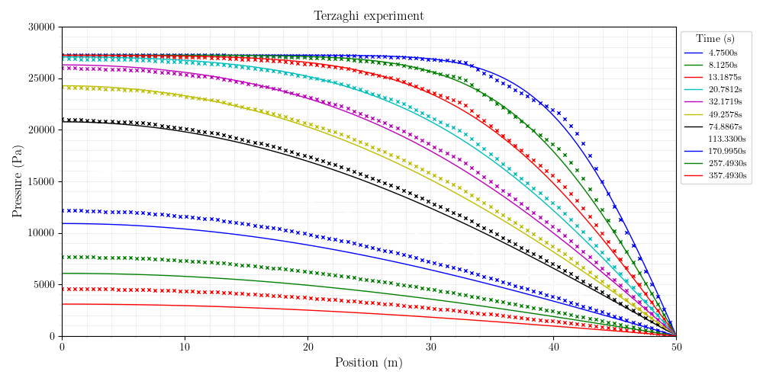
Mesh Information:
elem_dimensions()={3}
spatial_dimension()=3
n_nodes()=1798
n_local_nodes()=515
n_elem()=942
n_local_elem()=235
n_active_elem()=942
TERZAGHI, IMPLICIT

Slide 24
MANDEL – CRANK NICHOLSON

Slide 25
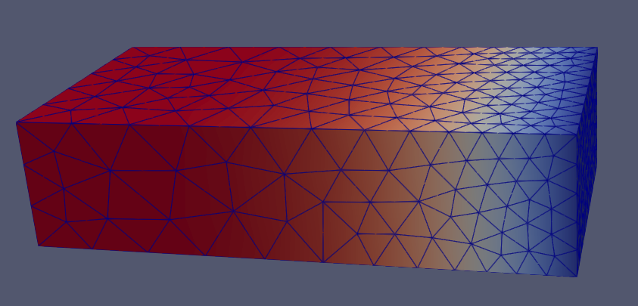
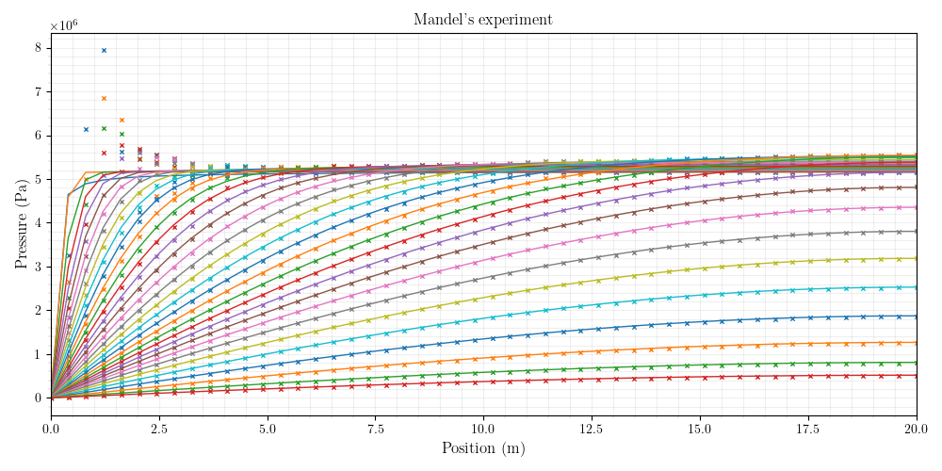
MANDEL – CRANK NICHOLSON
Mesh Information:
elem_dimensions()={3}
spatial_dimension()=3
n_nodes()=3188
n_local_nodes()=858
n_elem()=1756
n_local_elem()=439
n_active_elem()=1756

Slide 26
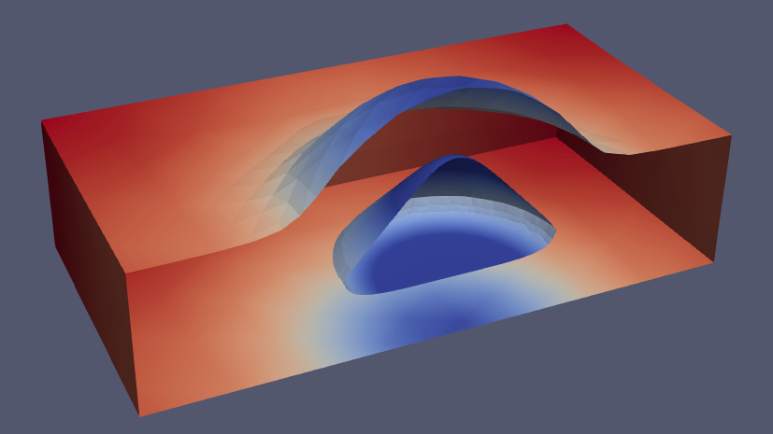
Mesh Information:
elem_dimensions()={3}
spatial_dimension()=3
n_nodes()=18045
n_local_nodes()=4867
n_elem()=12115
n_local_elem()=3028
n_active_elem()=12115
MASS BALANCE
197s

